Slide 1

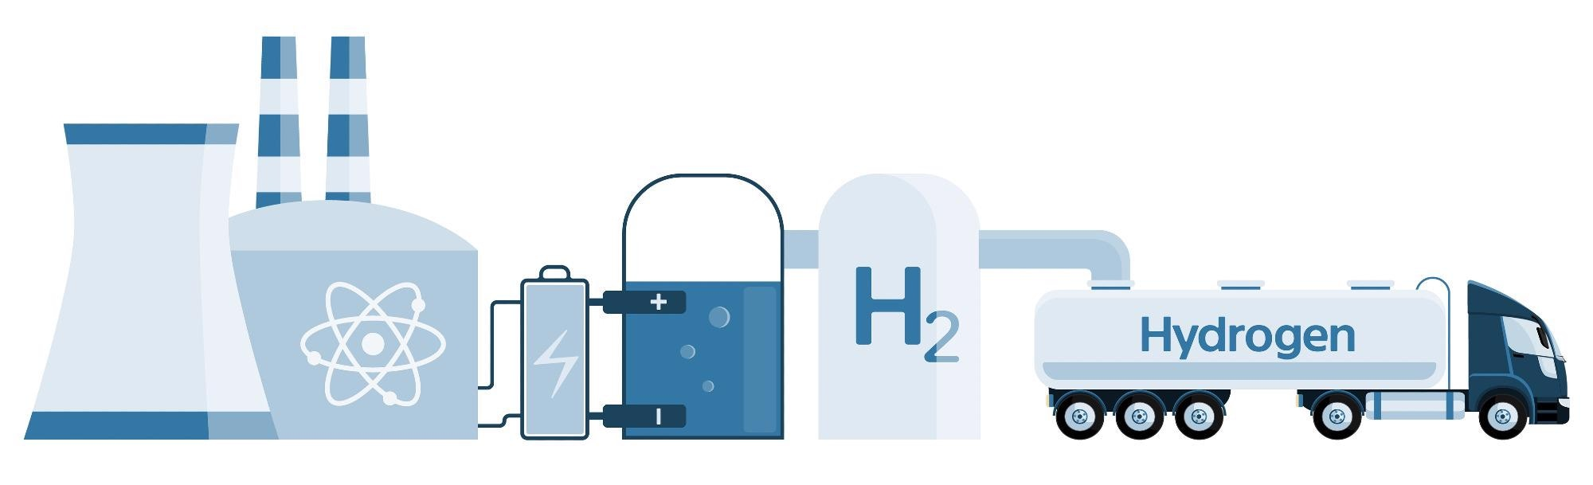
Nuclear Hydrogen Production
Nuclear Hydrogen Production
Cátia Ribeiro | 110962
Fábio Costa | 108090
Margarida Cavaleiro | 110886
Pedro Manuel | 96303

Slide 2




Members
Cátia Ribeiro
Pedro Manuel
Fábio Costa
Margarida Cavaleiro

Slide 3
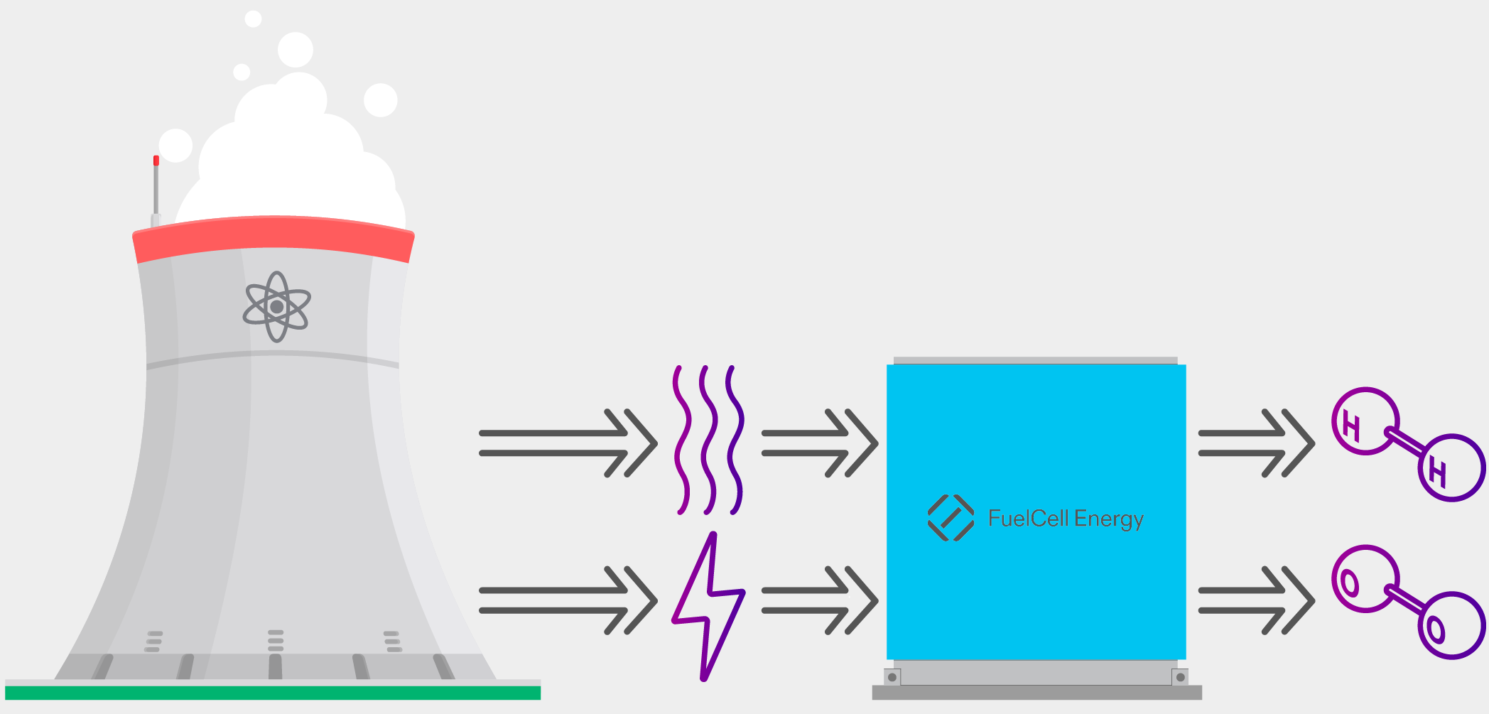
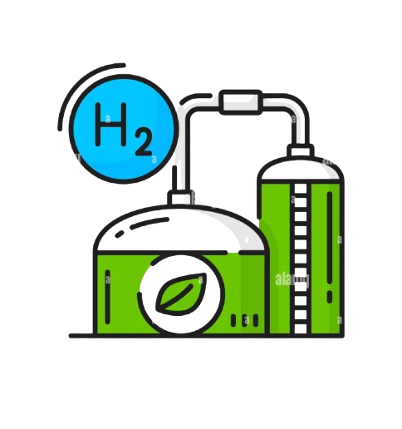
Agenda
Introduction
Nuclear Energy Applied to the Hydrogen Production
Future perspectives
Economic Analysis
Theoretical Fundamentals
Fig1: Schematic of Nuclear H₂ production

Slide 4
Introduction
1
Current Climate Context, Importance of H₂ in Our Economy, Introduction to Nuclear H₂

Slide 5
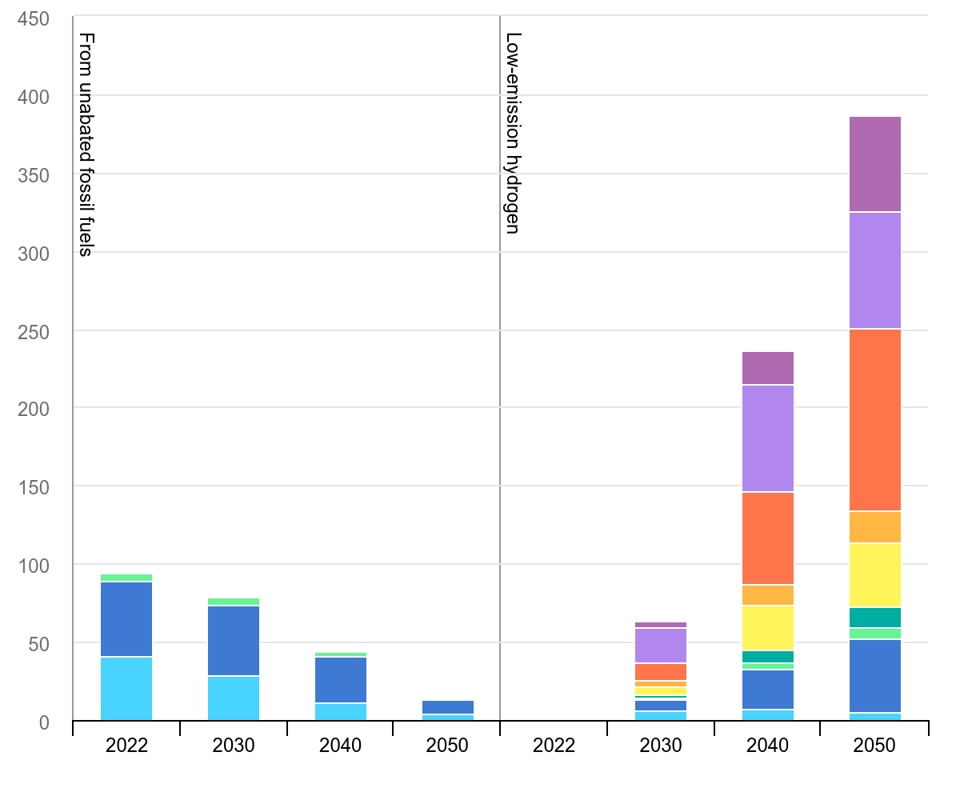
Introduction
As such the demand is incresing rapidly according to “The Global Hydrogen Review” from 2024, the Global hydrogen demand reached 97 Mt in 2023, an increase of 2.5% compared to 2022
The disadvantage being that almost all hydrogen today is made from carbon-based materials, with significant CO₂ emissions
So we need to make a shift to low-emission hydrogen production
Fig 2: Global hydrogen demand in the Net Zero Scenario 2022-2050
IEA in 2023, https://www.iea.org/data-and-statistics/charts/global-hydrogen-demand-in-the-net-zero-scenario-2022-2050

Slide 6
Theoretical Fundamentals
2
Nuclear Energy, Hydrogen Production

Slide 7
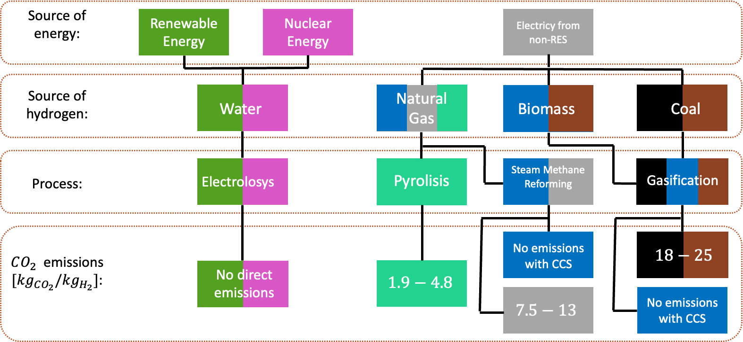
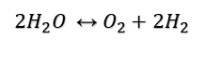
Hydrogen Colors
$2H_{2}O ↔{ O_{2}+2H}_{2}$
Fig 3: Hydrogen Colors
Incer-Valverde, J., Korayem, A., Tsatsaronis, G., & Morosuk, T. (2023). “Colors” of hydrogen: Definitions and carbon intensity. Energy Conversion and Management, 291, 117294

Slide 8
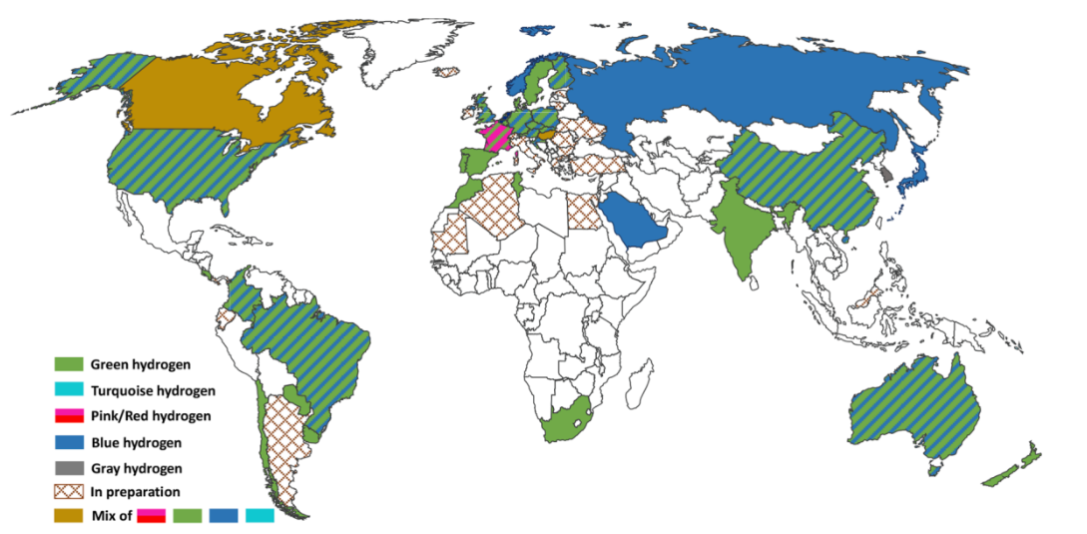
Hydrogen Colors
Fig 4: Worldwide plans for Hydrogen production
Incer-Valverde, J., Korayem, A., Tsatsaronis, G., & Morosuk, T. (2023). “Colors” of hydrogen: Definitions and carbon intensity. Energy Conversion and Management, 291, 117294.

Slide 9
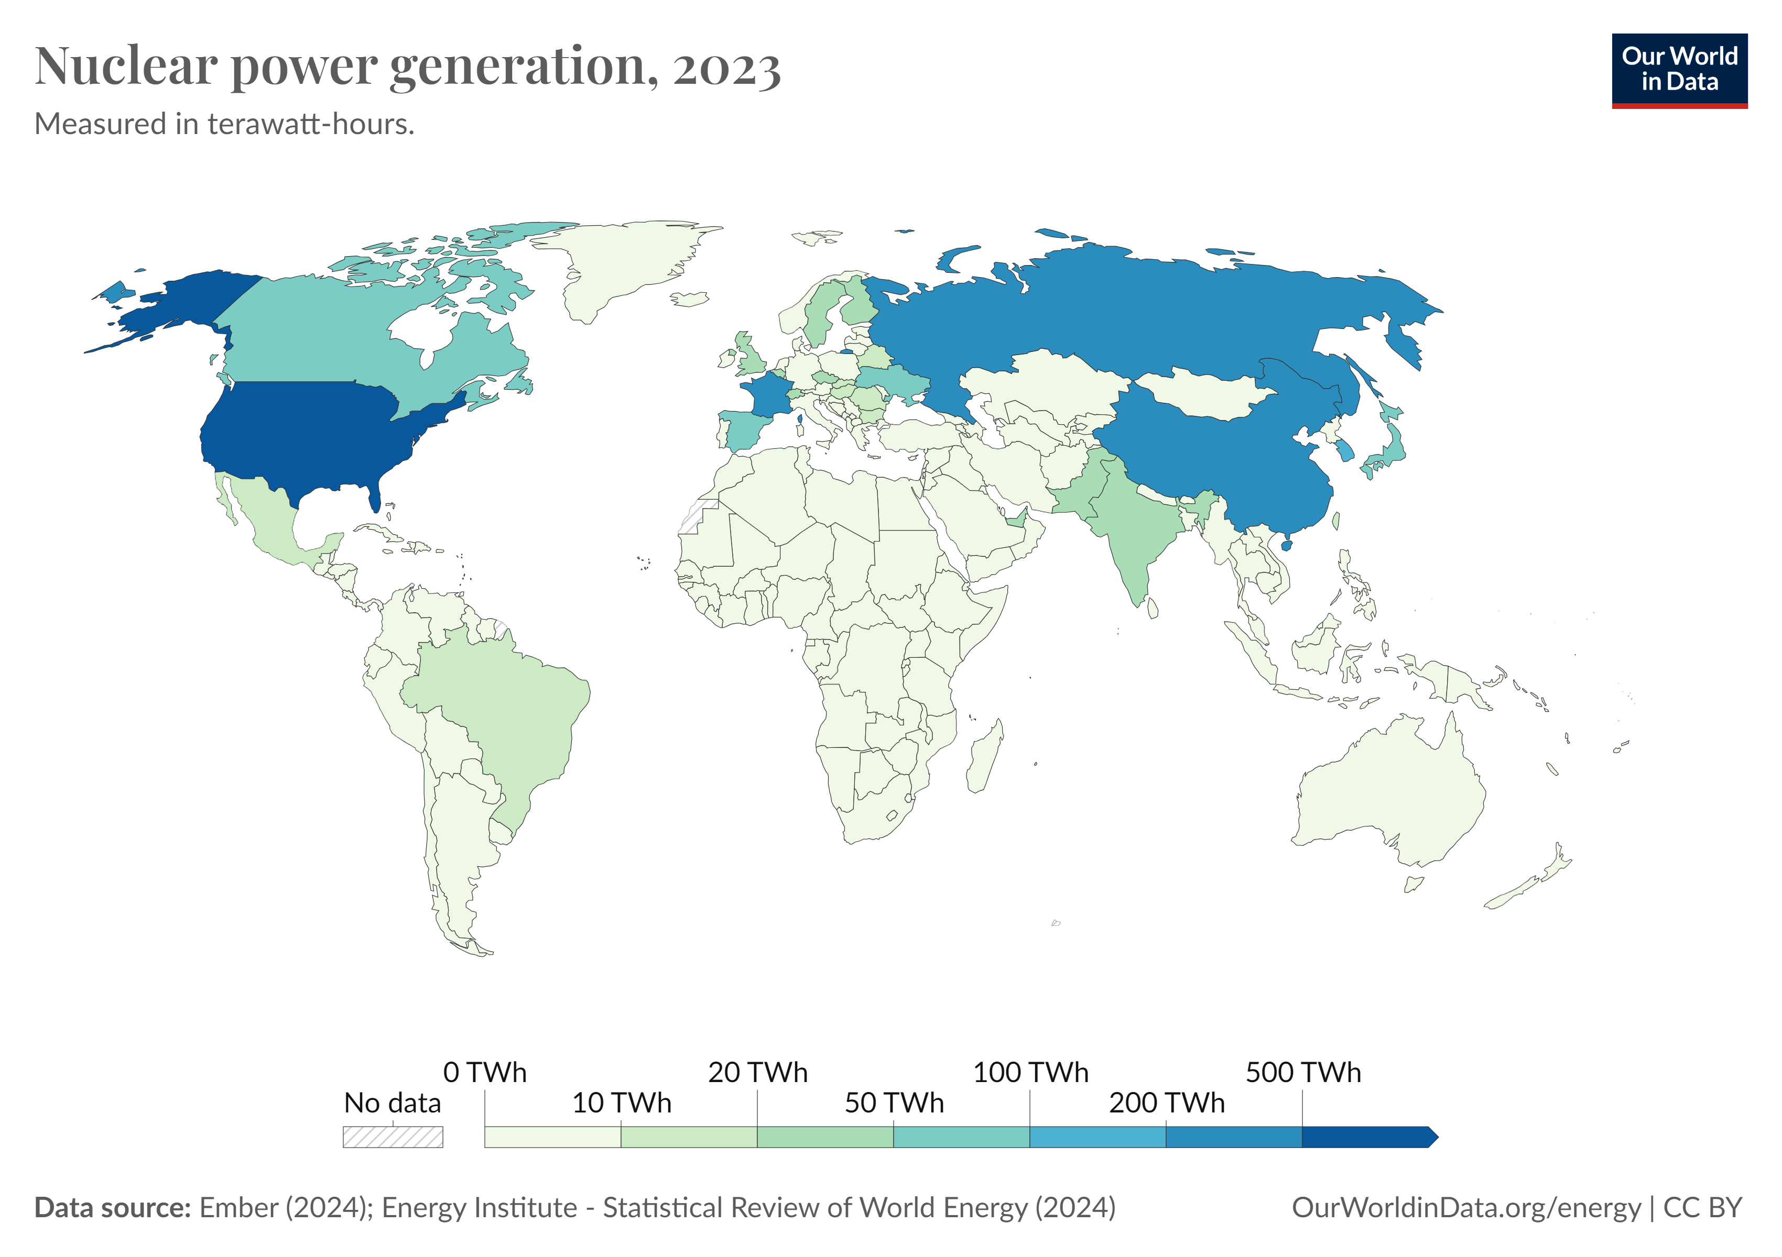
Nuclear Energy
Nuclear power generation has existed since the 1960s, seeing massive growth globally
Nuclear power plants operate in 32 countries
Its a baseload energy source
Has a very high capacity factor
No energy source is completelly safe, but there have been improvements in research
Fig 5: Nuclear Power Generation, by Our World in Data for 2023

Slide 10
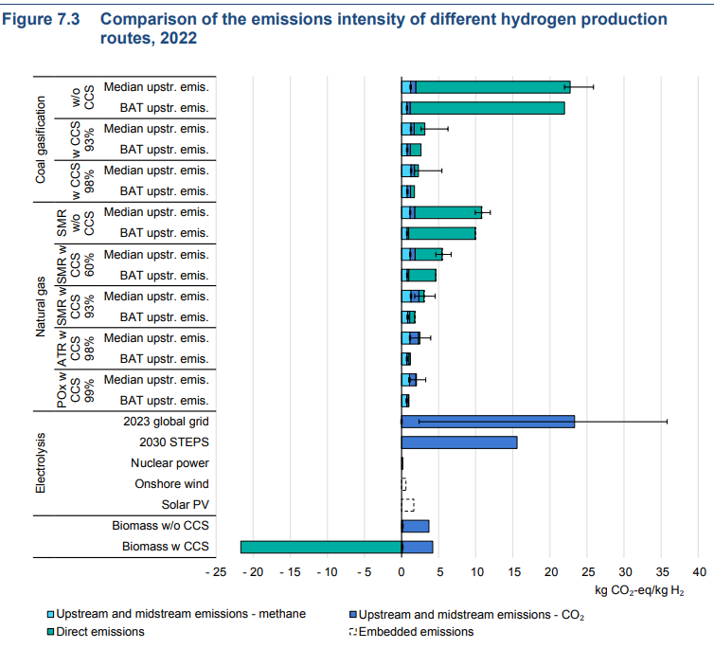



Why should we produce nuclear hydrogen ?
High demands of hydrogen in the future
Necessity of production from a source that is not so pollutant – low carbon emission projects
Needs of a non intermittent hydrogen production
Fig 6. Comparison of the emissions intensity of different hydrogen production routes, 2022 from the Global Hydrogen Report 2024.

Slide 11
Nuclear Energy for H2 Production
3
Water Electrolysis Using Nuclear Energy, High Temperature Thermolysis, Thermochemical Processes

Slide 12
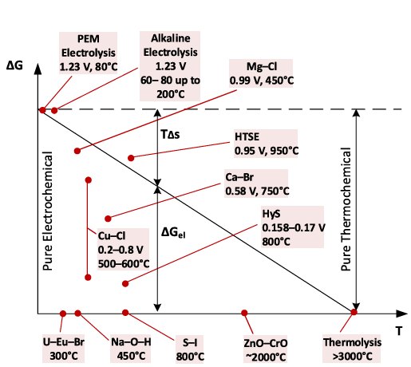
Methods
→ Electrolysis
→ Thermochemical processes
→ Thermolysis
Fig 7:R. Walker, P. Sabharwall, J. Hartvigsen, and J. O’Brien, “Comparative review of hydrogen production technologies for nuclear hybrid energy systems,” Progress in Nuclear Energy, 2020.

Slide 13
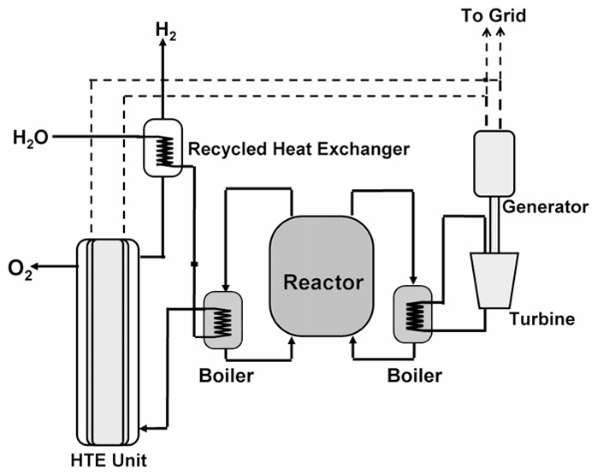
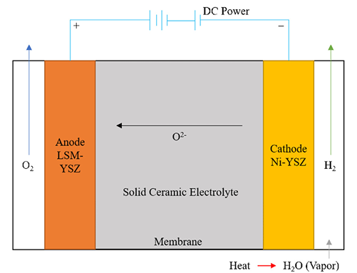
Electrolysis
Fig 8: Solid Oxide Electrolyser scheme
R. Walker, P. Sabharwall, J. Hartvigsen, and J. O’Brien, “Comparative review of hydrogen production technologies for nuclear hybrid energy systems,” Progress in Nuclear Energy, 2020.
Fig 9: Scheme of a HTE unit using nuclear energy
S. . Fujiwara,et al, “Hydrogen production by high temperature electrolysis with nuclearreactor,” Progress in Nuclear Energy, 2008

Slide 14

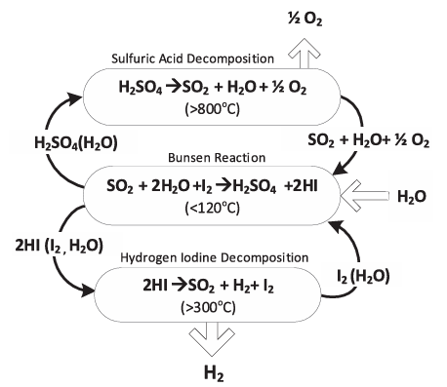
Thermochemical
S-I Cycle
✓ Large Scale production
✓ Competetive Cost
✓ High Efficiency
✗ Uncertainties in chemical kinetics
✗ Iodine availability
Fig 10: Sulfur Iodine cycle
R. Walker, P. Sabharwall, J. Hartvigsen, and J. O’Brien, “Comparative review of hydrogen production technologies for nuclear hybrid energy systems,” Progress in Nuclear Energy, 2020.

Slide 15
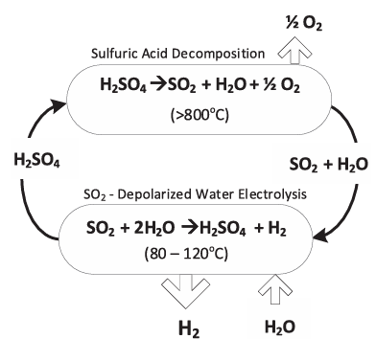
Thermochemical
HyS Cycle
✓ 1/3 of the electric power required for Electrolysis
✗ SO₂ crossover → improve catalysts
✗ Long term stable operation
Fig 11: Hybrid Sulfur cycle
R. Walker, P. Sabharwall, J. Hartvigsen, and J. O’Brien, “Comparative review of hydrogen production technologies for nuclear hybrid energy systems,” Progress in Nuclear Energy, 2020.

Slide 16
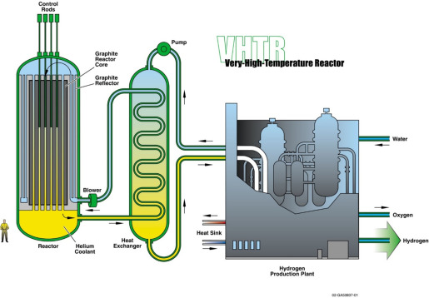
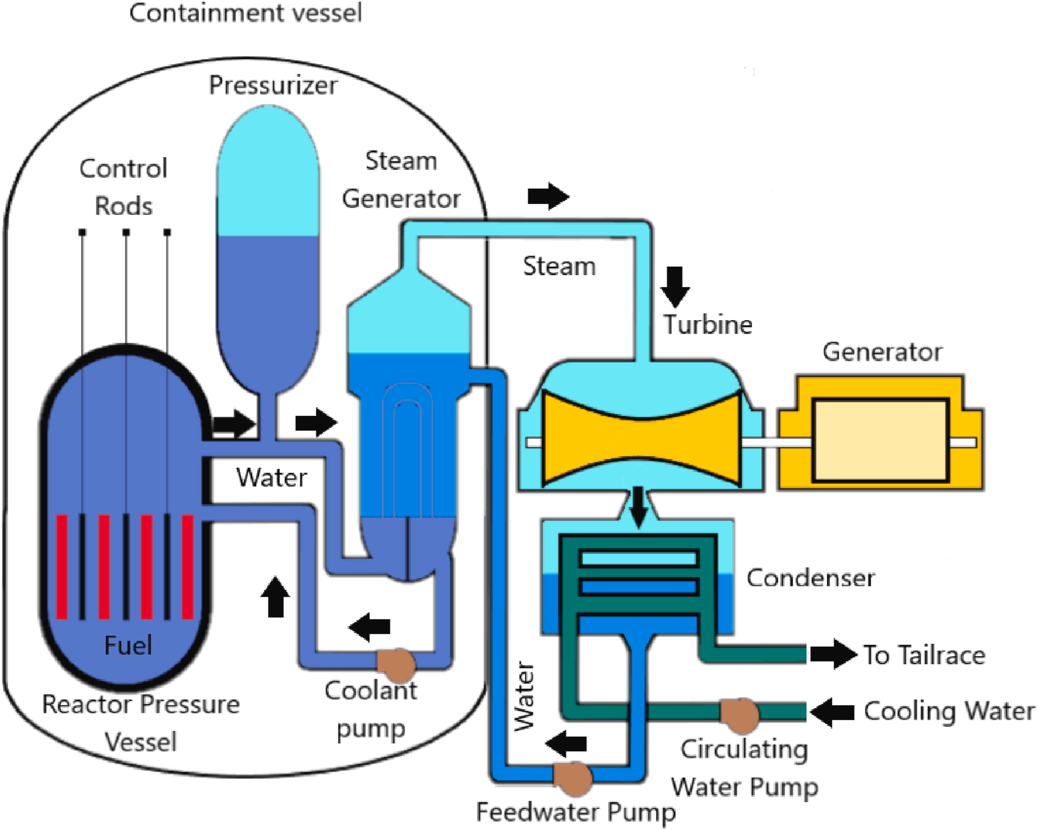
Reactors for H₂ production
High-Temperature Gas-Cooled Reactors
Advanced Pressurized Water Reactor
Fig 12: Joel Guidez, in Fast Reactors, 2023
Fig 13: Schematic of the PWR power plant, 2023

Slide 17
Economic Analysis
5
Hydrogen Economic Evaluation Program (HEEP)

Slide 18
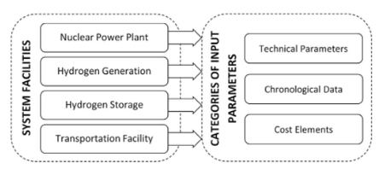
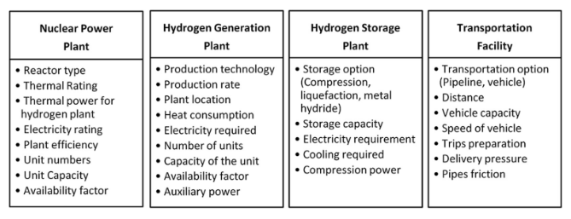
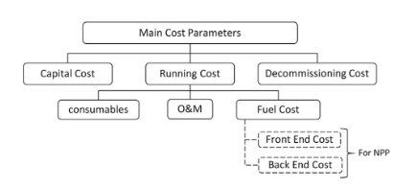
HEEP parameters
Fig 14: Categories of input parameters
Fig 15: Technical input parameters
Fig 16: Main cost parameters
I. K. R.S. El-Emam, “International collaboration in the iaea nuclear hydrogen production program forbenchmarking of heep,” International Journal of Hydrogen Energy, vol. 42, pp. 3566–3571, 2017.

Slide 19
Objectives
Examine the impact of production scale on the cost of nuclear hydrogen production
Compare nuclear hydrogen production cost with non-nuclear options
Determining the cost of hydrogen production

Slide 20
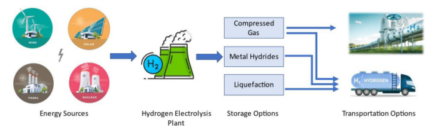
System description
Fig 17: Layout of the hydrogen production, storage and transportation system
Reactors
Electrolysis technologies
Advanced Pressurized Water (APWR)
High-Temperature Gas-Cooled (HTGR)
Conventional low temperature (CE)
High temperature (HTSE)
A. A. Alabbadi, O. A. Obaid, and A. A. AlZahrani, “A comparative economic study of nuclear hydrogen production, storage, and transportation,” International Journal of Hydrogen Energy, vol. 54, pp. 849–863,2024

Slide 21
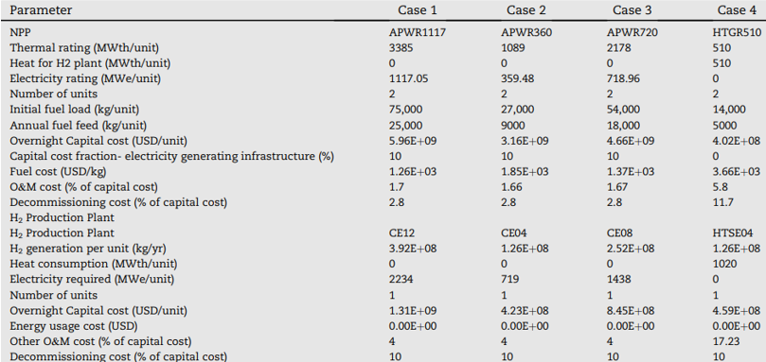
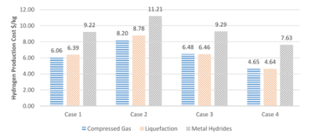
Results
Fig 19: Hydrogen production cost for the different cases and storage options
Fig 18: Nuclear hydrogen production parameters for 4 cases
A. A. Alabbadi, O. A. Obaid, and A. A. AlZahrani, “A comparative economic study of nuclear hydrogen production, storage, and transportation,” International Journal of Hydrogen Energy, vol. 54, pp. 849–863,2024

Slide 22
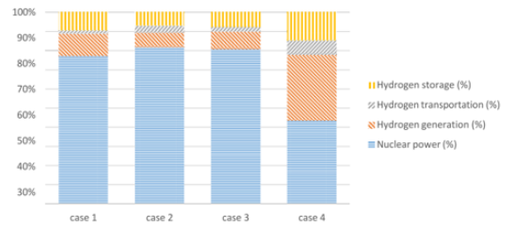
Results
Fig 20: Distribution of hydrogen production cost for the different cases
A. A. Alabbadi, O. A. Obaid, and A. A. AlZahrani, “A comparative economic study of nuclear hydrogen production, storage, and transportation,” International Journal of Hydrogen Energy, vol. 54, pp. 849–863,2024

Slide 23
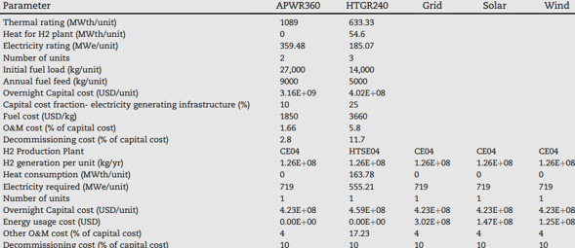
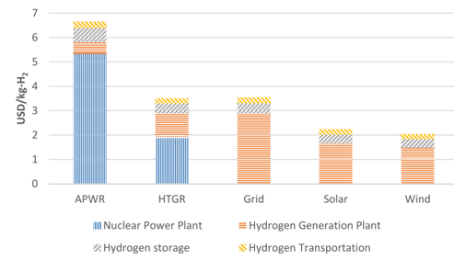
Results
Fig 21: Hydrogen production by electrolysis using different energy sources
Fig 22: Hydrogen production cost for the different sources
A. A. Alabbadi, O. A. Obaid, and A. A. AlZahrani, “A comparative economic study of nuclear hydrogen production, storage, and transportation,” International Journal of Hydrogen Energy, vol. 54, pp. 849–863,2024

Slide 24
Future Perspective
6
Challenges and Advantages, Nuclear Hydrogen Demonstration Projects

Slide 25


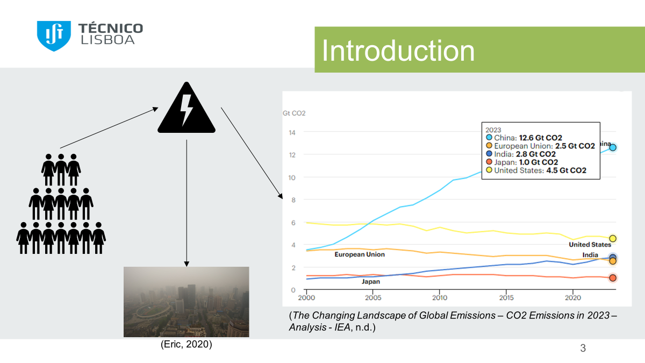
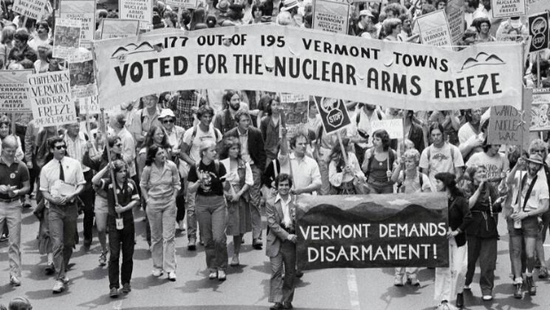
Challenges and Advantages
Main Advantages of Nuclear Hydrogen Production
Clean production
Large-scale hydrogen generation
Multiple production methods
Main Obstacles of Nuclear Hydrogen Production
High investments at long term to become operational
Public acceptance issues (safety, radioactive waste)
Need for advanced infrastructure and technical expertise
• Global opinions and environmental concerns shape nuclear strategies
• Varied national responses to the Fukushima accident
• Pro-nuclear arguments focus on safety and climate change benefits
• Anti-nuclear protests influence policies, especially in democracies
ICAN. (n.d.). The road to a world free of nuclear weapons. International Campaign to Abolish Nuclear Weapons

Slide 26
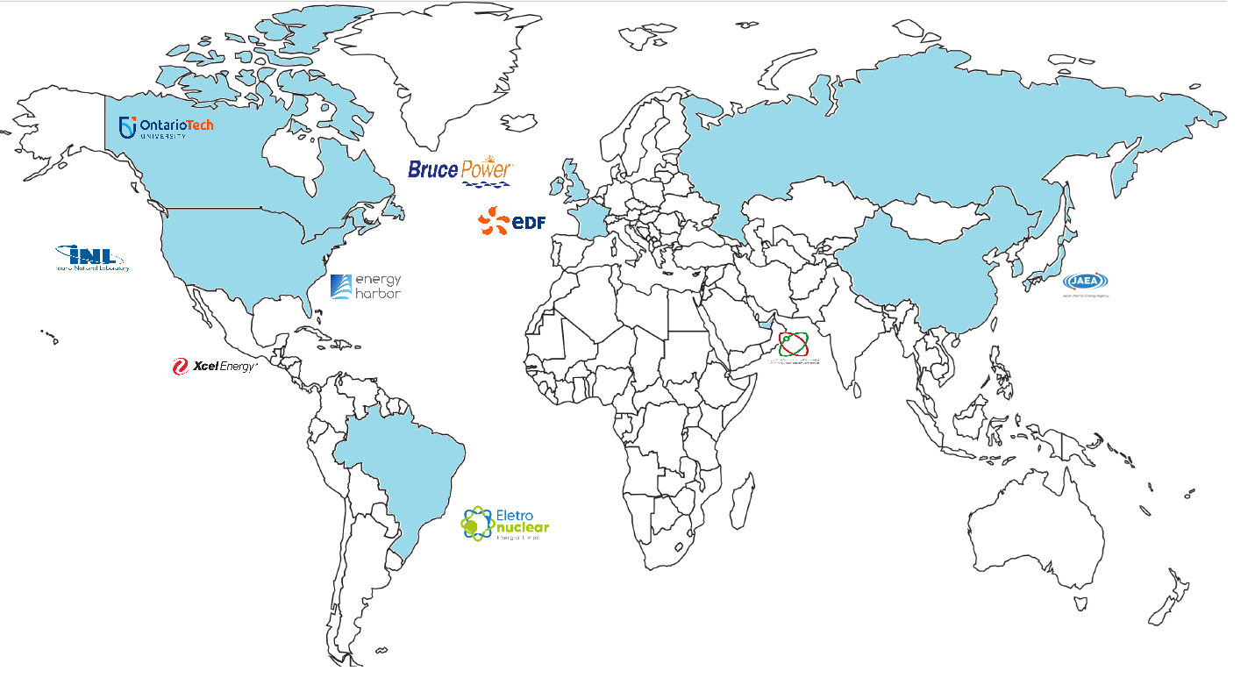
Nuclear hydrogen demonstration projects
Fig 23: World map of Nuclear Hydrogen production projects

Slide 27
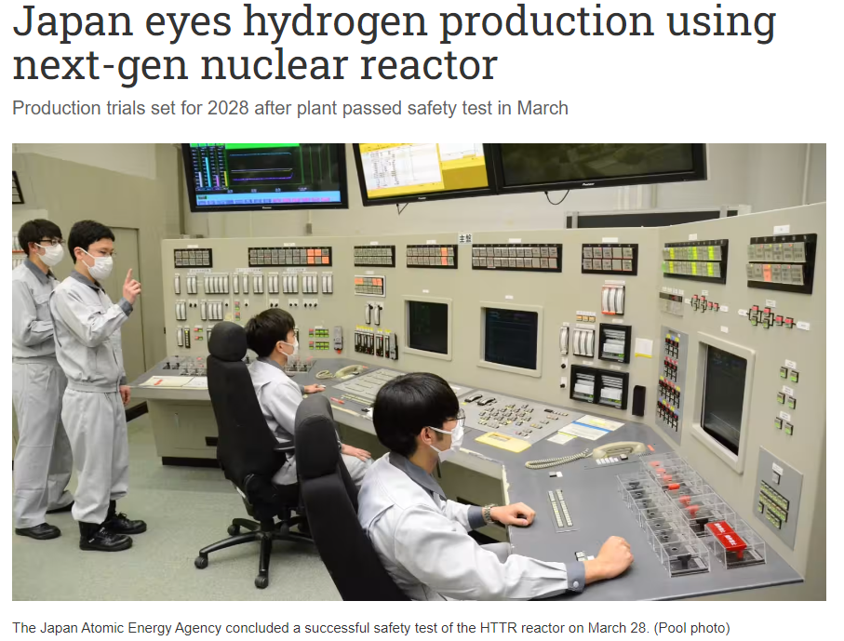

Nuclear hydrogen demonstration projects
Project created by the Japan Atomic Energy Agency
Using the High-Temperature Engineering Test Reactor (HTTR)
to establish HTGR technology and heat utilization technology
Fig 24: News from the Nikkei Asia, 2024, https://asia.nikkei.com/Business/Energy/Japan-eyes-hydrogen-production-using-next-gen-nuclear-reactor

Slide 28
Conclusion
7
Summary and Potentials

Slide 29




Conclusion
High Temperature Electrolysis and Thermochemical processes are the most promising technologies ;
The production of hydrogen using nuclear energy should be specifically mentioned in hydrogen plans as a zero-carbon pathway, with defined targets and indications for its achievement;
Combining nuclear and renewable energy systems to co-produce electricity and hydrogen will help meet market demand;
We need to accept that nuclear is a reality and should take advantage of that to decarbonize other sectors.

Slide 30
Thank you for
your attention!

Slide 31
Bibliography
S. Fujiwara, S. Kasai, H. Yamauchi, K. Yamada, S. Makino, K. Matsunaga, M. Yoshino, T. Kameda,T. Ogawa, S. Momma, and E. Hoashi, “Hydrogen production by high temperature electrolysis with nuclearreactor,” Progress in Nuclear Energy, vol. 50, no. 2, pp. 422–426, 2008.
R. Walker, P. Sabharwall, J. Hartvigsen, and J. O’Brien, “Comparative review of hydrogen productiontechnologies for nuclear hybrid energy systems,” Progress in Nuclear Energy, vol. 123, p. 103317, 05 2020.
K. R.S. El-Emam, “International collaboration in the iaea nuclear hydrogen production program forbenchmarking of heep,” International Journal of Hydrogen Energy, vol. 42, pp. 3566–3571, 2017.
A. A. Alabbadi, O. A. Obaid, and A. A. AlZahrani, “A comparative economic study of nuclear hydrogen production, storage, and transportation,” International Journal of Hydrogen Energy, vol. 54, pp. 849–863,2024
Incer-Valverde, J., Korayem, A., Tsatsaronis, G., & Morosuk, T. (2023). “Colors” of hydrogen: Definitions and carbon intensity. Energy Conversion and Management, 291, 117294.
Global hydrogen demand in the Net Zero Scenario, 2022-2050, by IEA in 2023, https://www.iea.org/data-and-statistics/charts/global-hydrogen-demand-in-the-net-zero-scenario-2022-2050
IEA in 2023, https://www.iea.org/data-and-statistics/charts/global-hydrogen-demand-in-the-net-zero-scenario-2022-2050

